Slide 1
IBM University Engagement Project Submission
“Exploring the Power of Agentic AI with IBM Granite and IBM Bob”

Slide 2
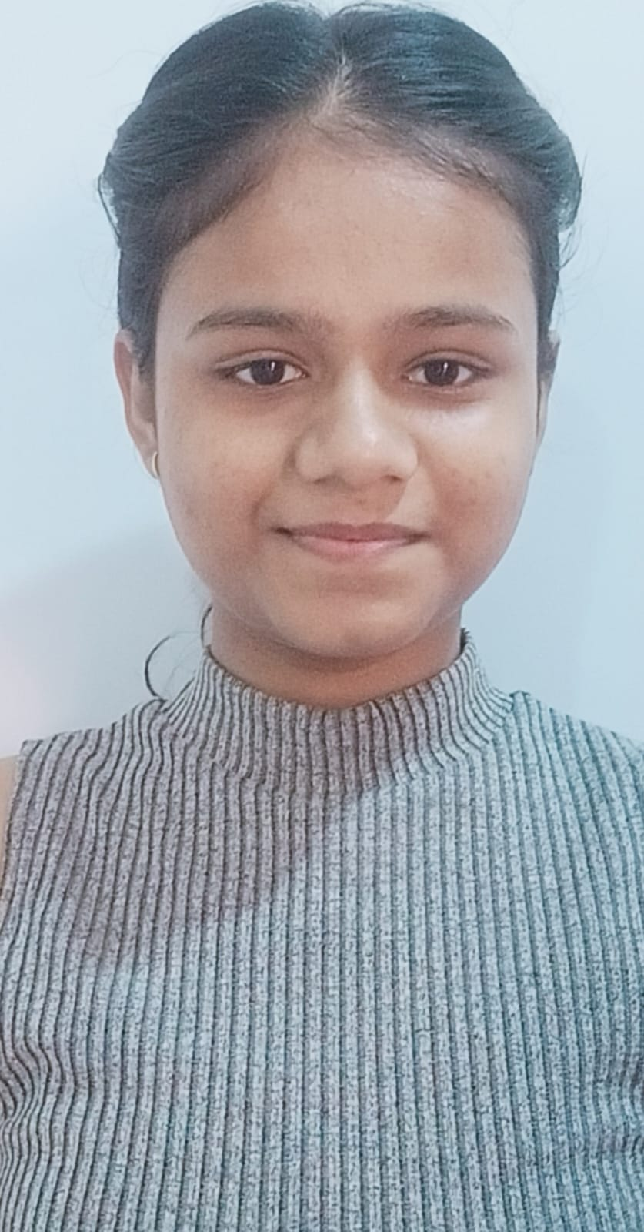
Project Tile – [RAG Agent for DIP Diet]
Domain of Project – [Healthcare / Nutrition]
Student Name | Recent Passport Photo | Email ID | Mobile number [WhatsApp]
Amrita Singh |  | amritas7705@gmail.com | 8770636697

Slide 3
Problem Statement -
Problem Statement : RAG Agent for DIP Diet
The Challenge
Health-conscious individuals and nutritionists often struggle with scattered diet plans, food charts, and wellness guidelines. The DIP Diet (Disciplined & Intelligent Plan) approach emphasizes natural foods and lifestyle discipline, but its resources—books, blogs, and expert advice—are fragmented and hard to personalize. The challenge is not just to retrieve diet information but to synthesize, personalize, and provide actionable dietary recommendations.
The Objective
Build a Vector Store RAG (Retrieval-Augmented Generation) Agent that serves as an intelligent diet assistant for DIP followers. The solution should:
Ingest & index DIP Resources – Collect diet plans, nutrition guides, and related health documents, and store them in a vector database for semantic search.
Enable Conversational Q&A – Allow users to ask natural questions (e.g., “What can I eat for breakfast in the DIP diet?”) and get clear, personalized responses.
Create a Personalized & Agentic Layer – Adapt diet suggestions based on user profile, lifestyle, medical conditions, or fitness goals while recommending food substitutions.
Visualize Diet Guidance – Provide a clean dashboard with daily/weekly meal plans, nutrition breakdown, and lifestyle tips to help users stay disciplined with DIP.
Tech Stack (Mandatory) IBM Langflow / IBM Orchestrate + IBM Model.

Slide 4
Proposed Solution -
Proposed Solution: DIP Diet RAG Agent
The proposed solution is an AI-powered RAG Agent for DIP Diet built using IBM Langflow / IBM Orchestrate and IBM Models to provide personalized and intelligent dietary guidance. The system addresses the challenges of scattered DIP Diet resources, information retrieval, personalization, and actionable diet planning through an intelligent RAG-based architecture.
At its core, the solution uses a Retrieval-Augmented Generation (RAG) pipeline to retrieve relevant information from DIP Diet resources such as diet plans, nutrition guides, books, blogs, and health documents. The retrieved information is stored and searched using a vector database, enabling IBM Models to generate accurate and context-aware responses.
The system provides the following key capabilities:
DIP Knowledge Retrieval Agent – Retrieves relevant information from the DIP Diet knowledge base using semantic search and RAG.
Diet Recommendation Agent – Generates personalized meal suggestions based on the user's profile, lifestyle, preferences, and fitness goals
Food Substitution Agent – Recommends suitable food alternatives based on available DIP Diet information..
Conversational Q&A Agent – Allows users to ask natural-language questions and receive clear, relevant answers.
IBM Langflow / IBM Orchestrate is used to design and orchestrate the agent workflow, while IBM Models power natural-language understanding, reasoning, summarization, and personalization.
Overall, the solution provides an intelligent, personalized, and knowledge-grounded DIP Diet assistant that transforms scattered diet resources into practical and actionable dietary guidance.

Slide 5
Technology Used
IBM Langflow / IBM Orchestrate - For designing, connecting, and orchestrating the RAG Agent workflow.
IBM model - For designing, connecting, and orchestrating the RAG Agent workflow.
IBM Cloud – Provides the infrastructure to build, deploy, and scale the DIP Diet RAG Agent efficiently.
RAG (Retrieval-Augmented Generation) – Retrieves relevant information from DIP Diet resources before generating responses, making the assistant more reliable and knowledge-grounded.
Vector Database – Stores document embeddings and enables semantic search to retrieve relevant DIP Diet information.
Python – Used for data processing, application logic, and integration of the RAG components.

Slide 6

Role of Agentic AI in the solution
Role of Agentic AI in Nutrition Agent
Agentic AI enables the Nutrition Agent to function as an intelligent, autonomous system rather than a simple chatbot. Using IBM watsonx.ai and IBM Granite models, it coordinates multiple specialized agents to deliver personalized nutrition guidance.
Each agent performs a specific role—such as retrieving nutritional data, generating diet plans, providing health advice, and analyzing food logs—while working collaboratively. This multi-agent approach ensures efficient task execution and accurate results.
Agentic AI also brings context awareness, understanding user details like age, health conditions, and fitness goals to generate tailored recommendations. It supports real-time adaptation, continuously updating suggestions based on user inputs like daily meals.
Additionally, agents communicate with each other, enabling better decision-making and improved outcomes.
Overall, Agentic AI makes the system proactive, personalized, and goal-driven, acting like a smart digital nutritionist that helps users maintain a healthy lifestyle.

Slide 7
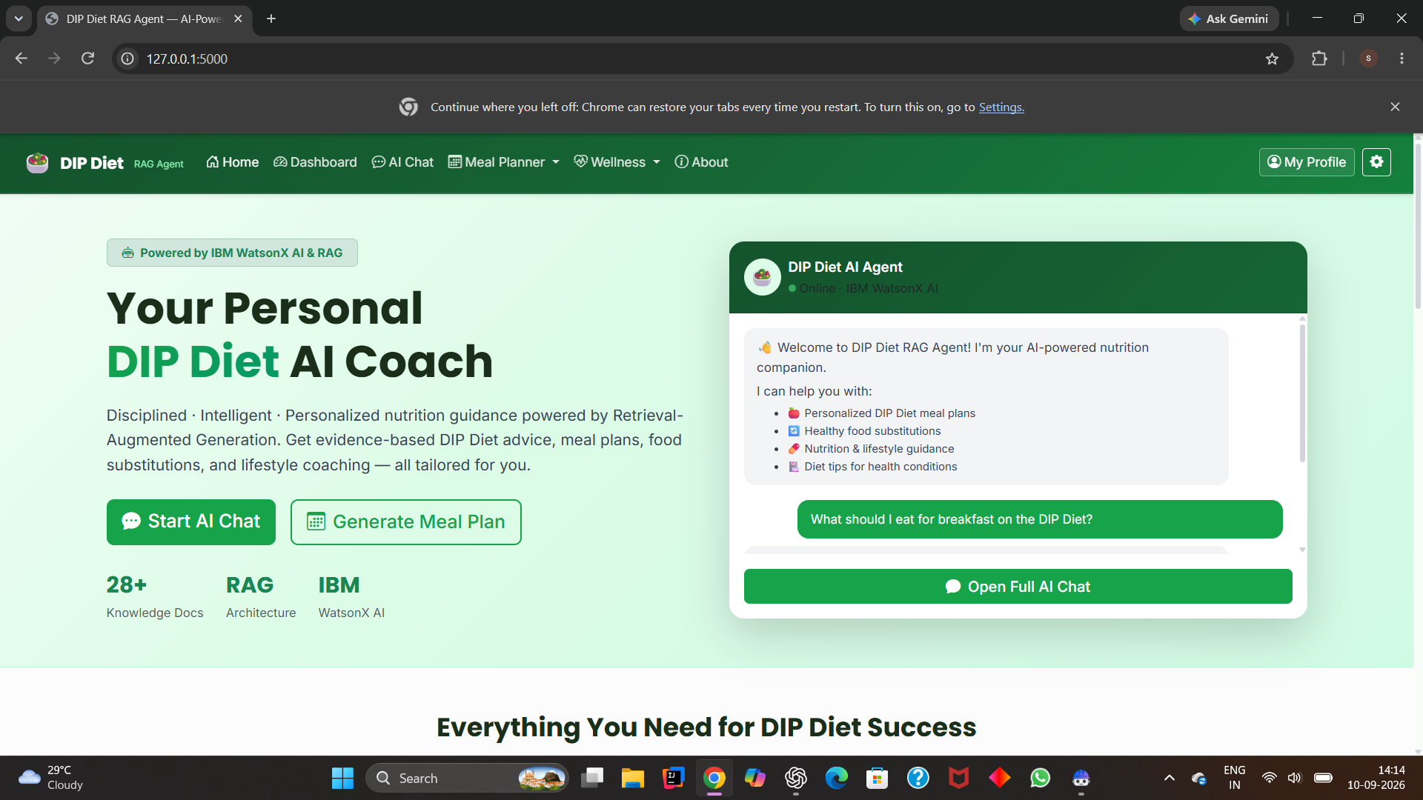
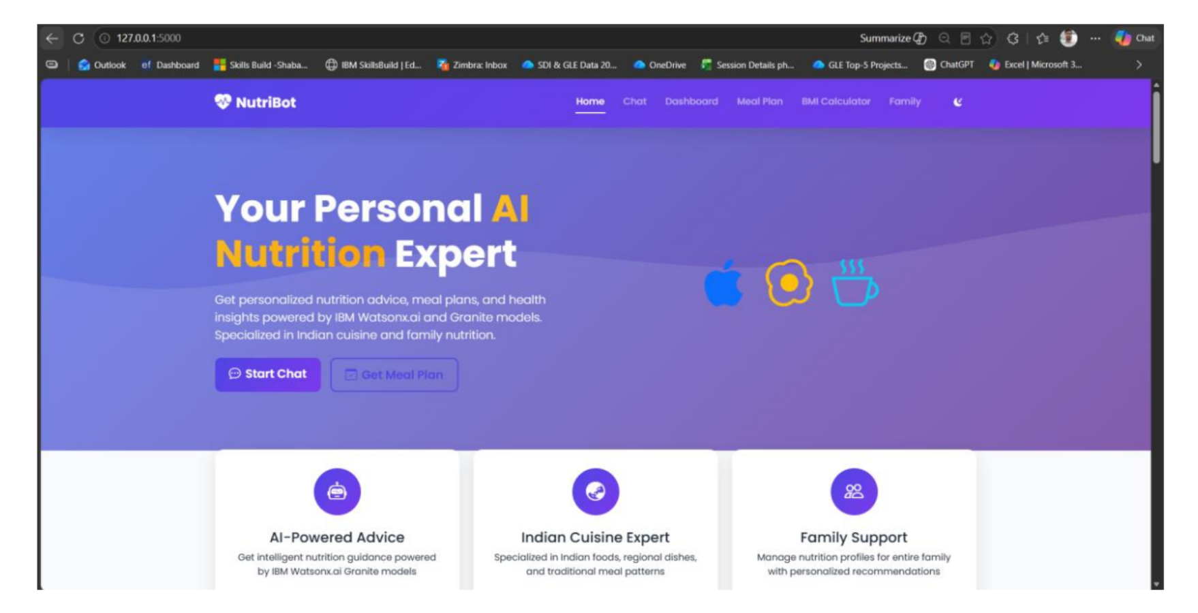
Project Output Screenshot
Please put IBM Bob output screenshots with 2-3 prompts.
You can take 2-3 more slides for each screenshot
·
·
·

Slide 8
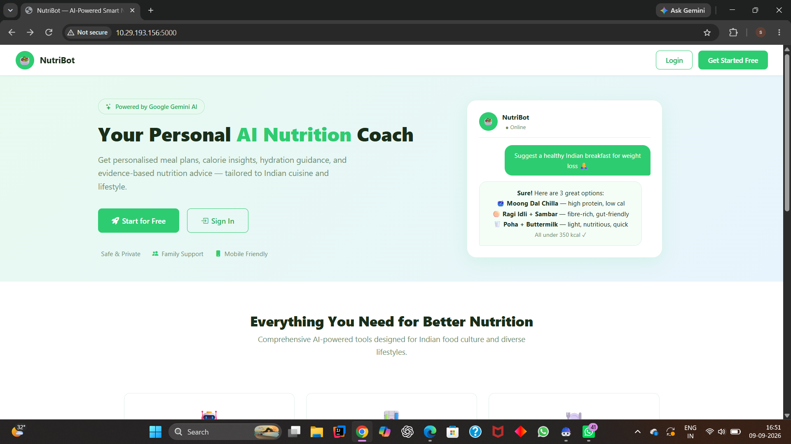
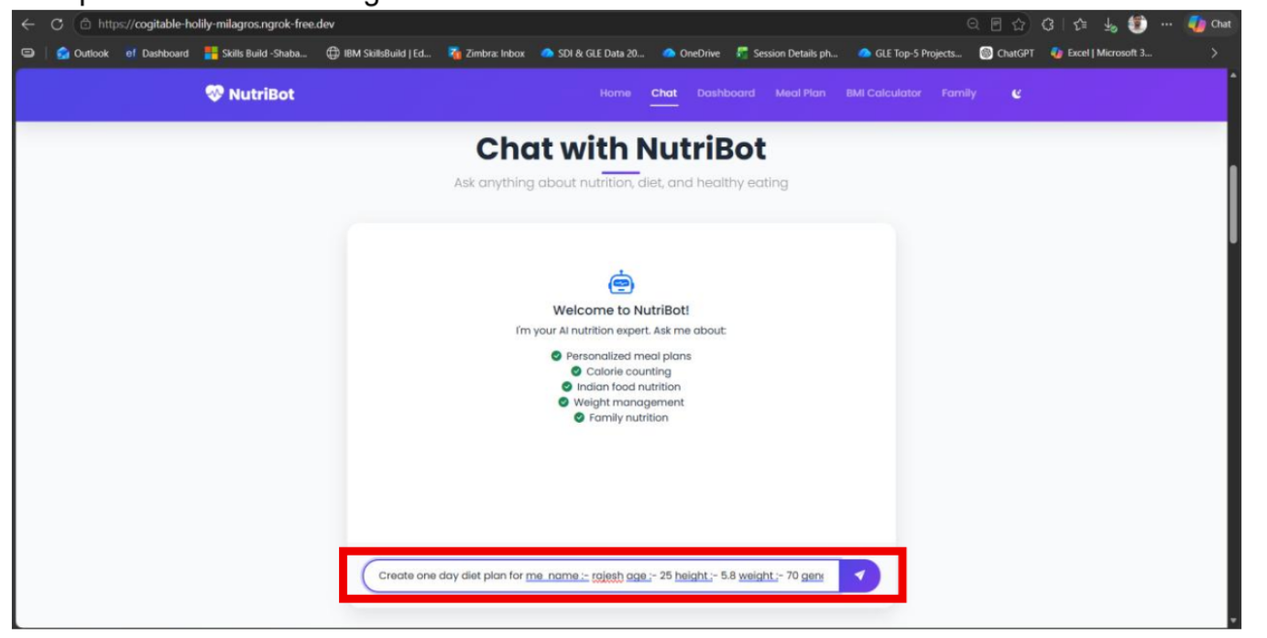
Project Output Screenshot
Please put IBM Bob output screenshots with 2-3 prompts.
You can take 2-3 more slides for each screenshot
·
·
·

Slide 9
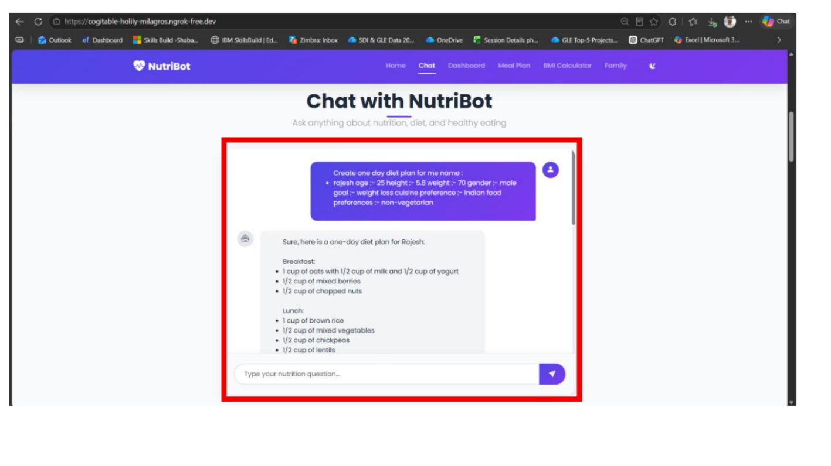
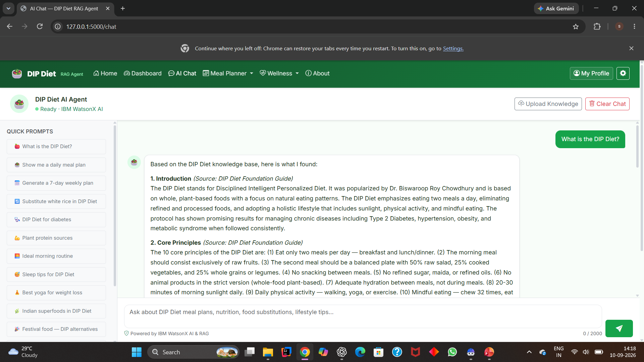
Project Output Screenshot
Please put IBM Bob output screenshots with 2-3 prompts.
You can take 2-3 more slides for each screenshot
·
·
·

Slide 10
Novelty and Uniqueness
The proposed DIP Diet RAG Agent stands out by combining RAG, Agentic AI, and personalization to provide intelligent and knowledge-grounded diet guidance.
RAG-Based DIP Knowledge Retrieval – Retrieves relevant information from DIP Diet resources using semantic search instead of relying only on the model's general knowledge.
2. Personalized Diet Guidance – Adapts suggestions according to the user's lifestyle, dietary preferences, and fitness goals.
3. Conversational Q&A – Allows users to ask natural-language questions and receive clear, context-aware answers.
4. Smart Food Substitution – Suggests suitable alternatives when a user cannot consume a particular food.
5. Actionable Recommendations – Converts retrieved DIP Diet information into practical meal suggestions and lifestyle tips.
6. Agentic AI Workflow – Combines retrieval, reasoning, personalization, and response generation into an intelligent workflow.
7. Scalable Knowledge Base – New DIP Diet resources can be added to the vector database, allowing the system's knowledge base to grow over time.
Overall, the solution transforms scattered DIP Diet resources into a smart, personalized, and interactive digital diet assistant, rather than a simple static chatbot.

Slide 11
Git Hub Link
https://github.com/amritasingh005/DIP-Diet-RAG-Agent
·
·
·

Slide 12
Future Scope
Multilingual & Voice-Based DIP Diet Assistant The system can be enhanced with voice interaction and multiple languages such as Hindi and English, making DIP Diet guidance more accessible to a wider range of users.
2. Wearable & Fitness Device Integration Integration with smartwatches and fitness trackers can provide activity, sleep, and fitness data to improve personalized diet recommendations.
3. Advanced Personalization The agent can learn from user preferences, lifestyle patterns, dietary restrictions, and fitness goals to provide more personalized meal plans and food substitutions.
4. Mobile Application The RAG Agent can be developed into a mobile application for convenient access to DIP Diet guidance anytime and anywhere.
·
·
·

Slide 13
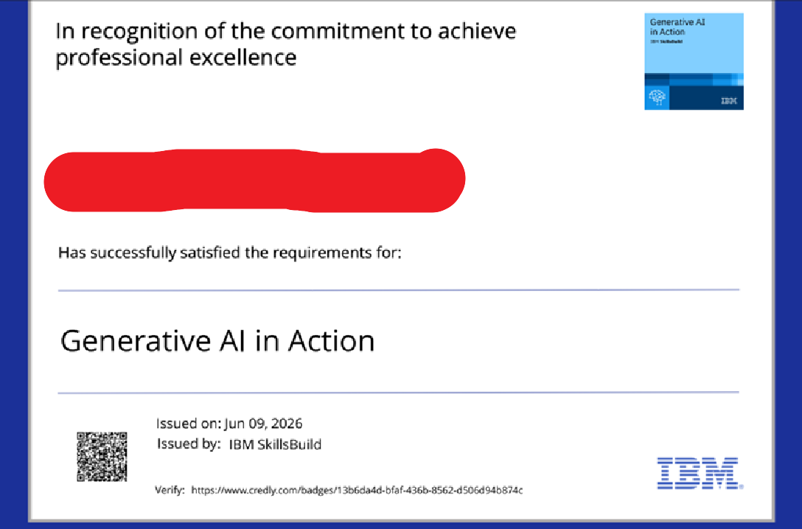
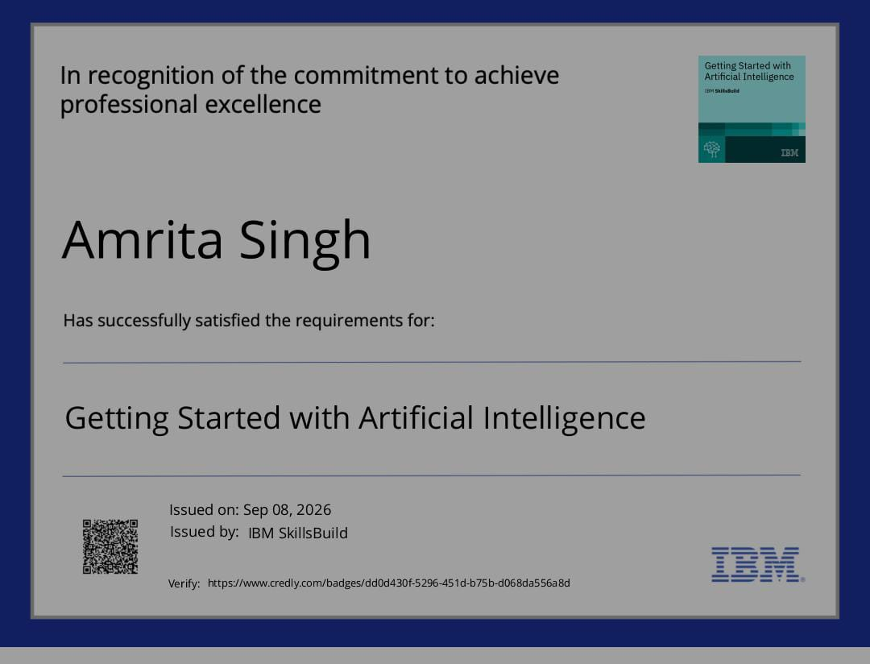
Certificates Earned:
Please add your credly certificate

Slide 14
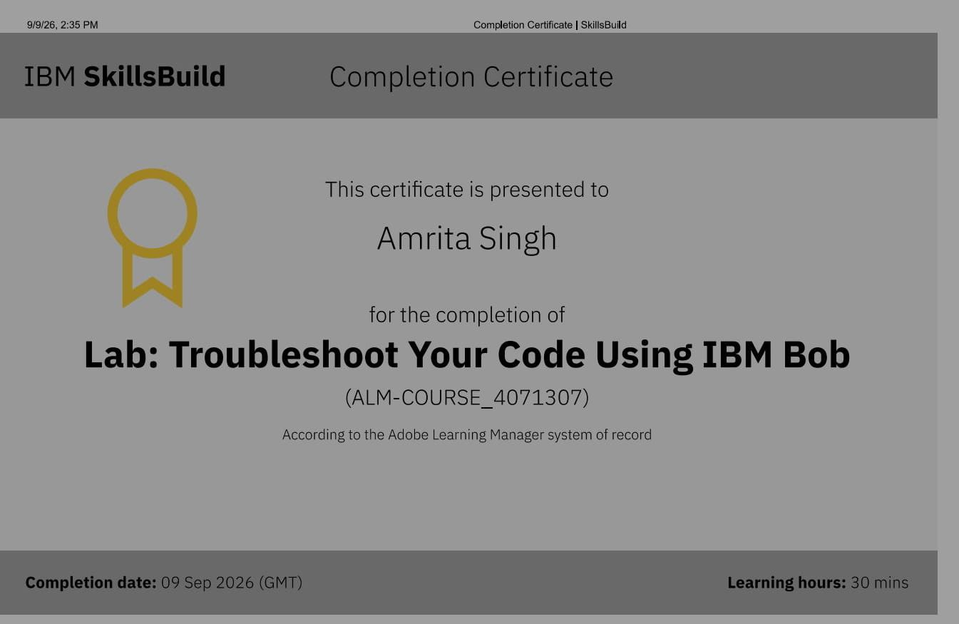
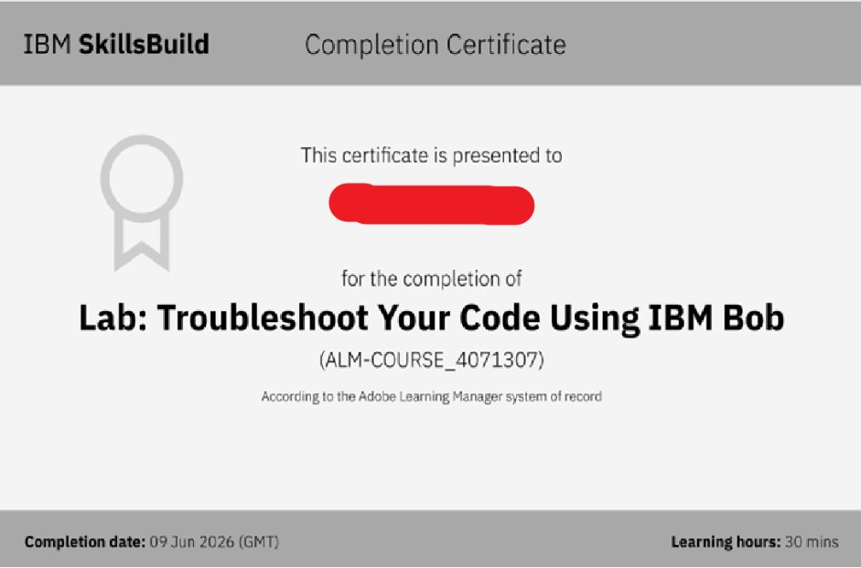
Certificates Earned:​
Add your IBM BOB Certificate

Slide 15


